Slide 1

Design and Implementation of a Database Management System for Cooperative Society Membership and Savings Management
Daibala Sowmya · Roll No. 25WU0102331
Notes:
Introduce the project as a relational database system for managing cooperative society membership and savings-related work. Preview the four ideas: entities, keys, relationships, and implementation safeguards.

Slide 2
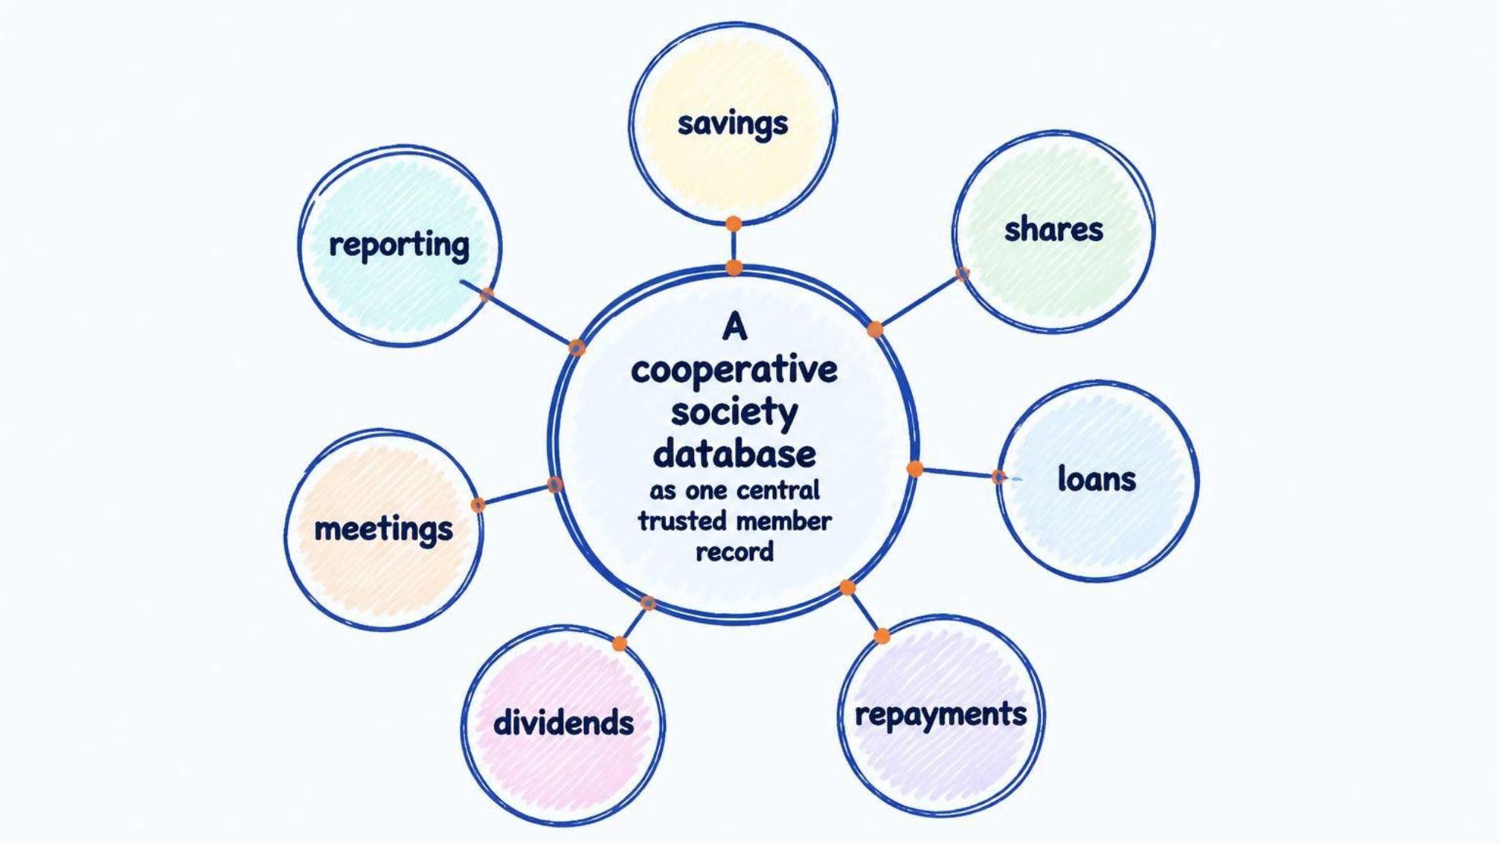
One trusted record connects every cooperative service
Organize members, savings, shares, loans, repayments, dividends, and meetings in one relational database.
Improve accurate record-keeping, retrieval, and reporting.
Scope: data design, relationships, key types, implementation, and safeguards.
Notes:
Explain that the system is not just a list of tables. Its value comes from connecting the services around a consistent member record, so information can be retrieved and reported more reliably.

Slide 3
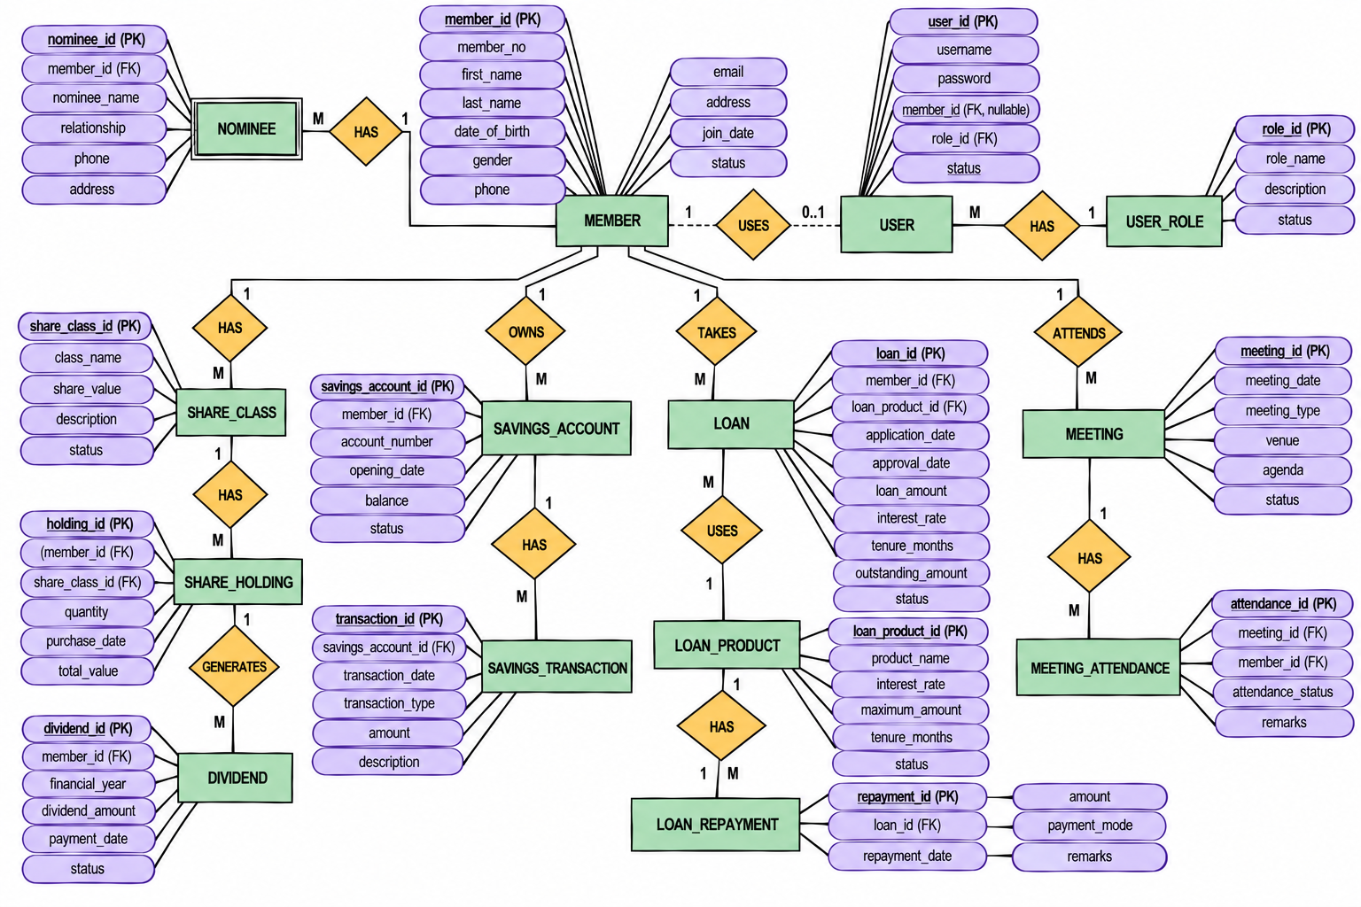
Notes:
Walk through the fourteen entities by group. Emphasize that the ER design makes the cooperative's work visible before implementation begins, while the diagram itself should be treated as a proposed design.

Slide 4
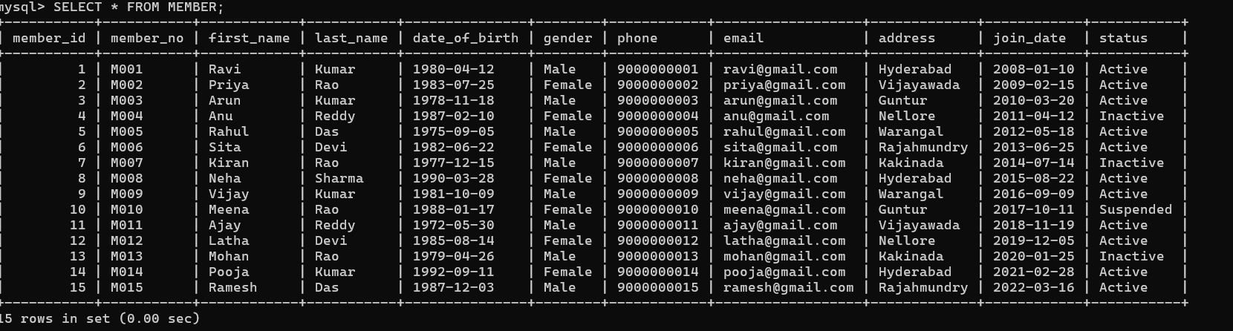
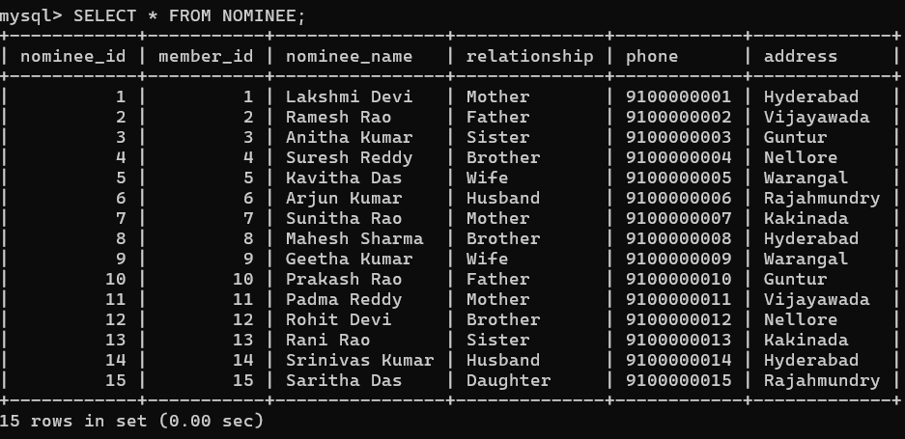

Slide 5
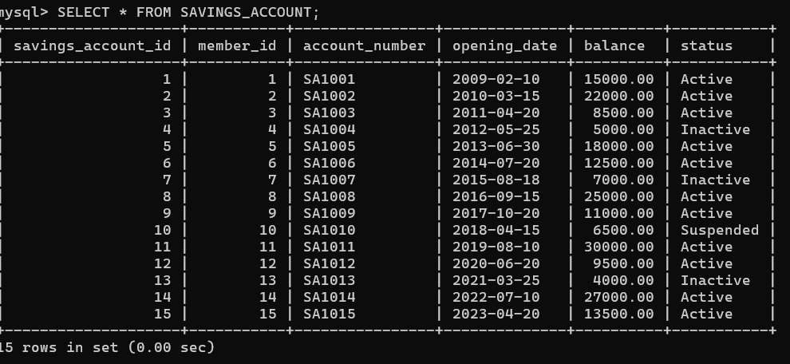
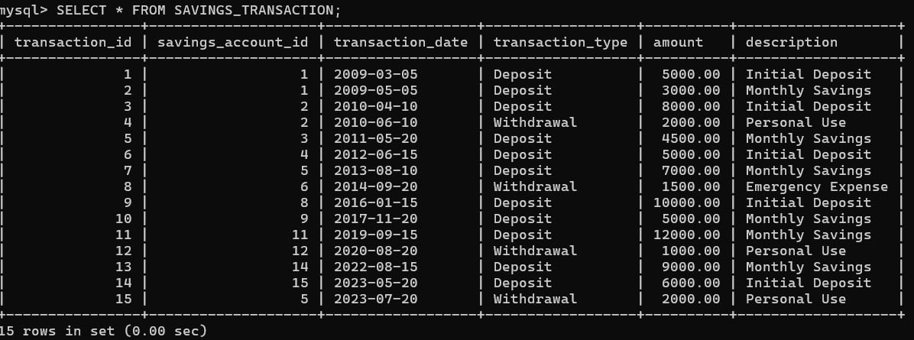

Slide 6
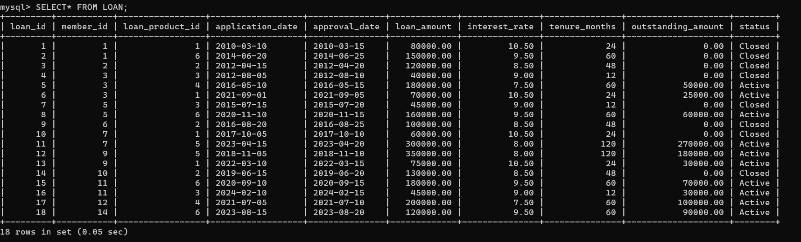
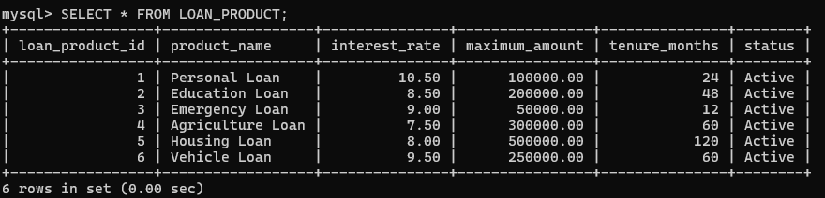

Slide 7
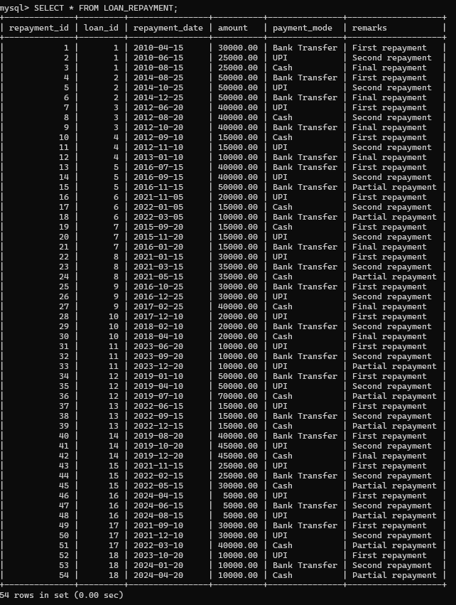
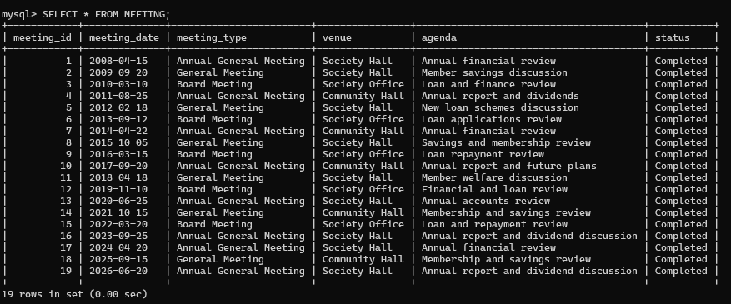

Slide 8
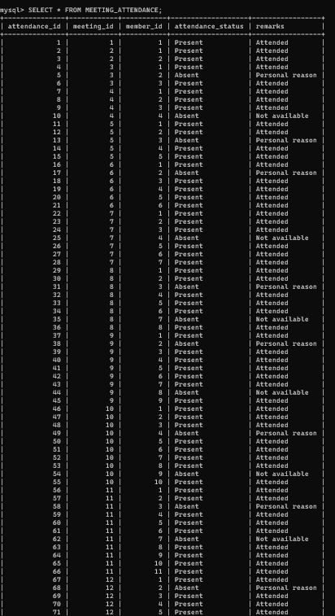
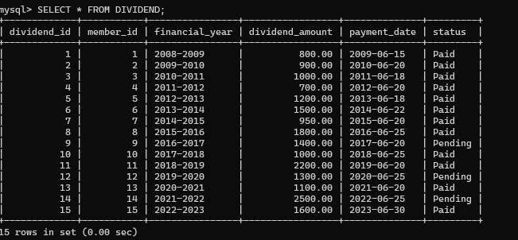

Slide 9
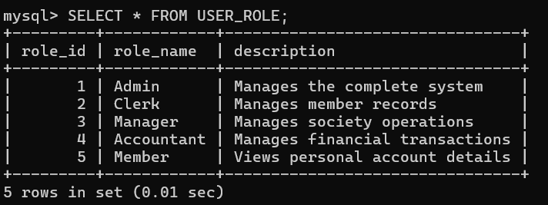
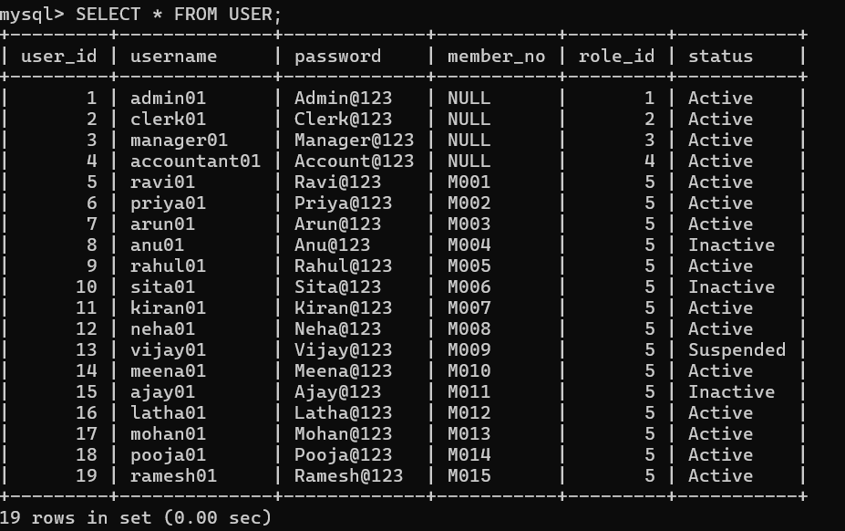

Slide 10
Relationship cardinality in the ER design
The table translates the diagram's connectors into readable parent–child cardinalities.
Parent entity | Child entity | Cardinality | Linking field
MEMBER | NOMINEE | 1 : many | member_id
MEMBER | SHARE_HOLDING | 1 : many | member_id
SHARE_CLASS | SHARE_HOLDING | 1 : many | share_class_id
MEMBER | SAVINGS_ACCOUNT | 1 : many | member_id
SAVINGS_ACCOUNT | SAVINGS_TRANSACTION | 1 : many | savings_account_id
MEMBER | LOAN | 1 : many | member_id
LOAN_PRODUCT | LOAN | 1 : many | loan_product_id
LOAN | LOAN_REPAYMENT | 1 : many | loan_id
MEMBER | DIVIDEND | 1 : many | member_id
MEETING | MEETING_ATTENDANCE | 1 : many | meeting_id
MEMBER | MEETING_ATTENDANCE | 1 : many | member_id
USER_ROLE | USER | 1 : many | role_id
MEETING_ATTENDANCE is the linking entity for the member–meeting many-to-many pattern represented by the two one-to-many rows.

Slide 11
RDBMS relational schema from the ER design
Relations, key fields, and directly labeled unique fields from the supplied cooperative-society diagram.
Relation | Primary key | Foreign key field(s) | Unique
MEMBER | member_id | — | member_no
NOMINEE | nominee_id | member_id | —
SHARE_CLASS | share_class_id | — | —
SHARE_HOLDING | holding_id | member_id; share_class_id | —
SAVINGS_ACCOUNT | savings_account_id | member_id | account_number
SAVINGS_TRANSACTION | transaction_id | savings_account_id | —
LOAN_PRODUCT | loan_product_id | — | —
LOAN | loan_id | member_id; loan_product_id | —
LOAN_REPAYMENT | repayment_id | loan_id | —
DIVIDEND | dividend_id | member_id | —
MEETING | meeting_id | — | —
MEETING_ATTENDANCE | attendance_id | meeting_id; member_id | —
USER_ROLE | role_id | — | —
USER | user_id | role_id | —
This is a relational-schema view of the diagram, not a claim that the database has already been implemented.

Slide 12

THANK
YOU
Notes:
Close by connecting the design choices to trust. Ask the oral-check question and invite the audience to answer: the foreign key connects the loan record to the member through the referenced member key.

